Slide 1


ANDROID website-www.coursera.org
NAME:DIVYA GUPTA
COURSE: BTECH(CSE)
ROLL NO.: 43(1011428)

Slide 2


The Vanderbilt University is located in The United States of America.

Slide 3
5 COURSE SPECIALIZATION
JAVA FOR ANDROID[4 weeks]
ANDROID APP COMPONENTS - Services, Local IPC, and Content Providers[4 weeks]
ANDROID APP COMPONENTS - Intent, Activities and Broadcast Receivers[4 weeks]
Engineering Maintainable Android Apps[4 weeks]
"Android App Development“[4 weeks]

Slide 4

OBJECTIVE
JAVA already learnt.
Reliability on smartphones & devices.
Next step to take information further and learn further.

Slide 5
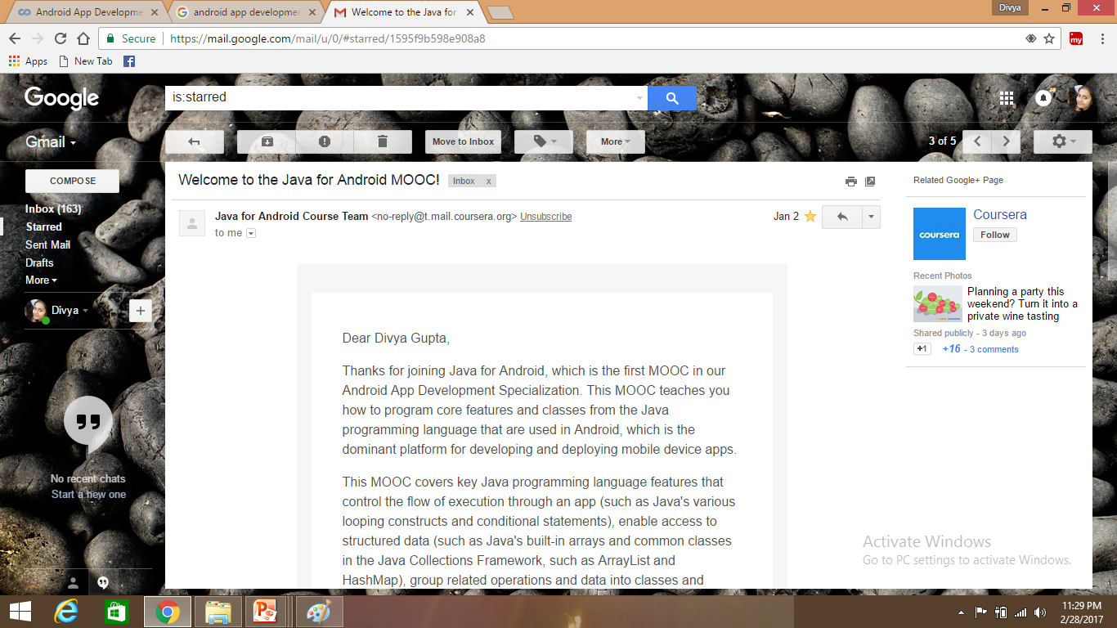
SCREENSHOT:

Slide 6

INTRODUCTION
Operating system, developed by Google.
Based on the Linux kernel
Primarily for smartphones and tablets.
Android TV for televisions .
Android Auto for cars.
Android Wear for wrist watches.

Slide 7
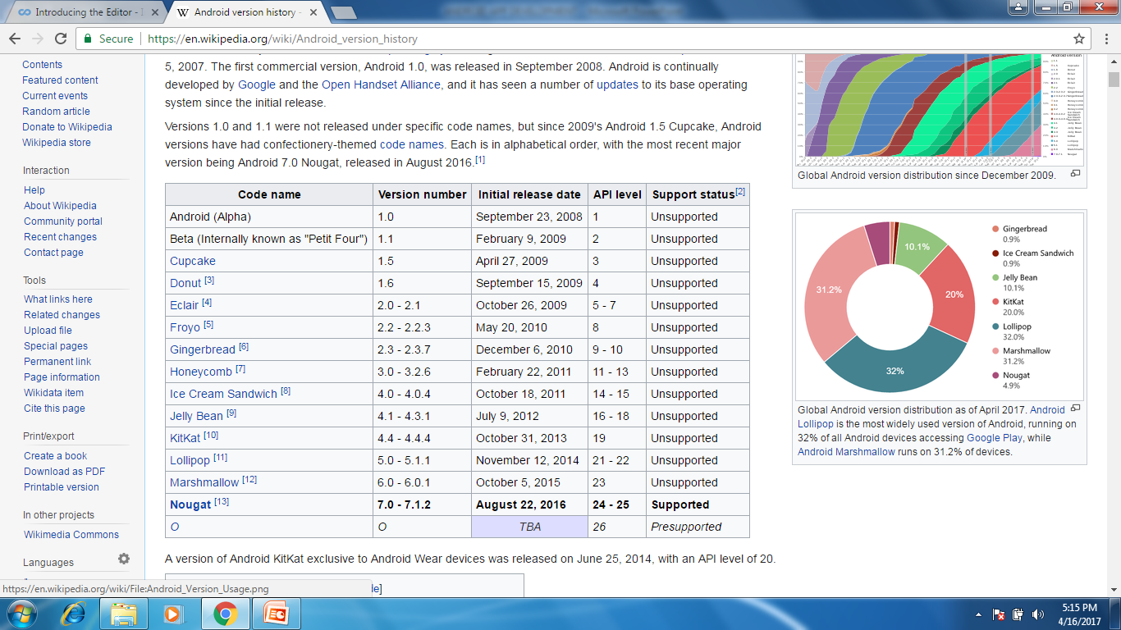
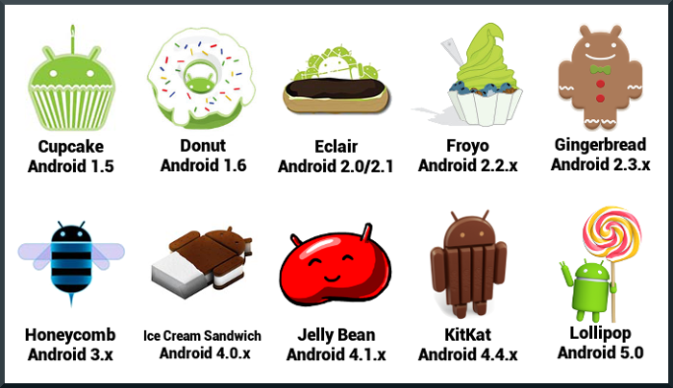
HISTORY : ANDROID VERSIONS

Slide 8
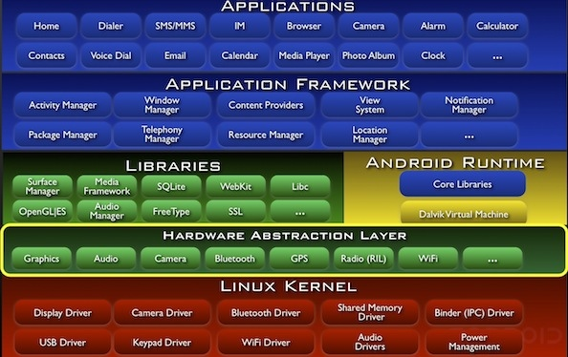
Layered Architecture : Android Kernel

Slide 9
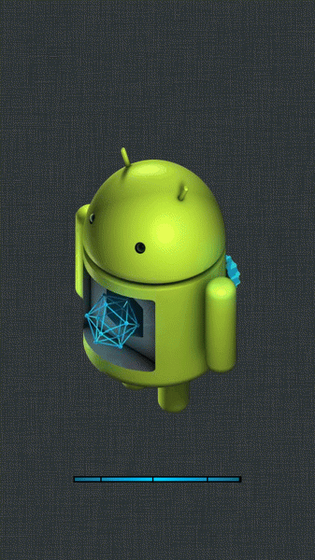
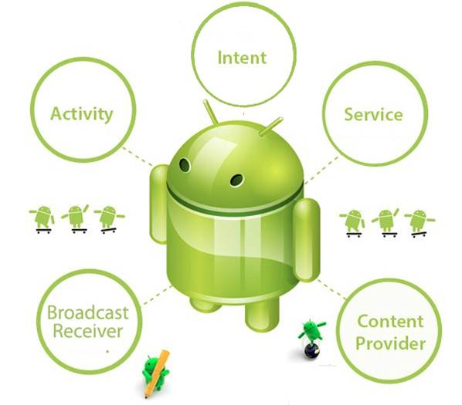
Components:

Slide 10

Tool Used : Android Studio
Version : 2.2.3
Introducing the IDE

Slide 11
Start to Create an Android App
Step 1:
click on Start a new android project on it.
Step 2:
Name your application.
then click on next.

Slide 12
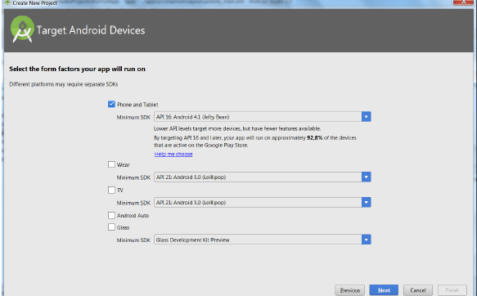
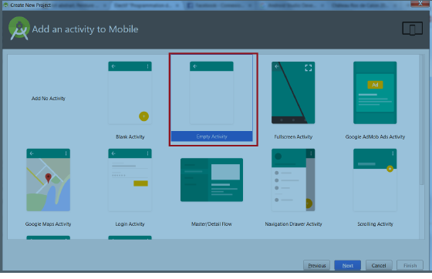
Step 3:
select Android O.S version according to SDK and platform.
Step 4:
select an Activity.

Slide 13
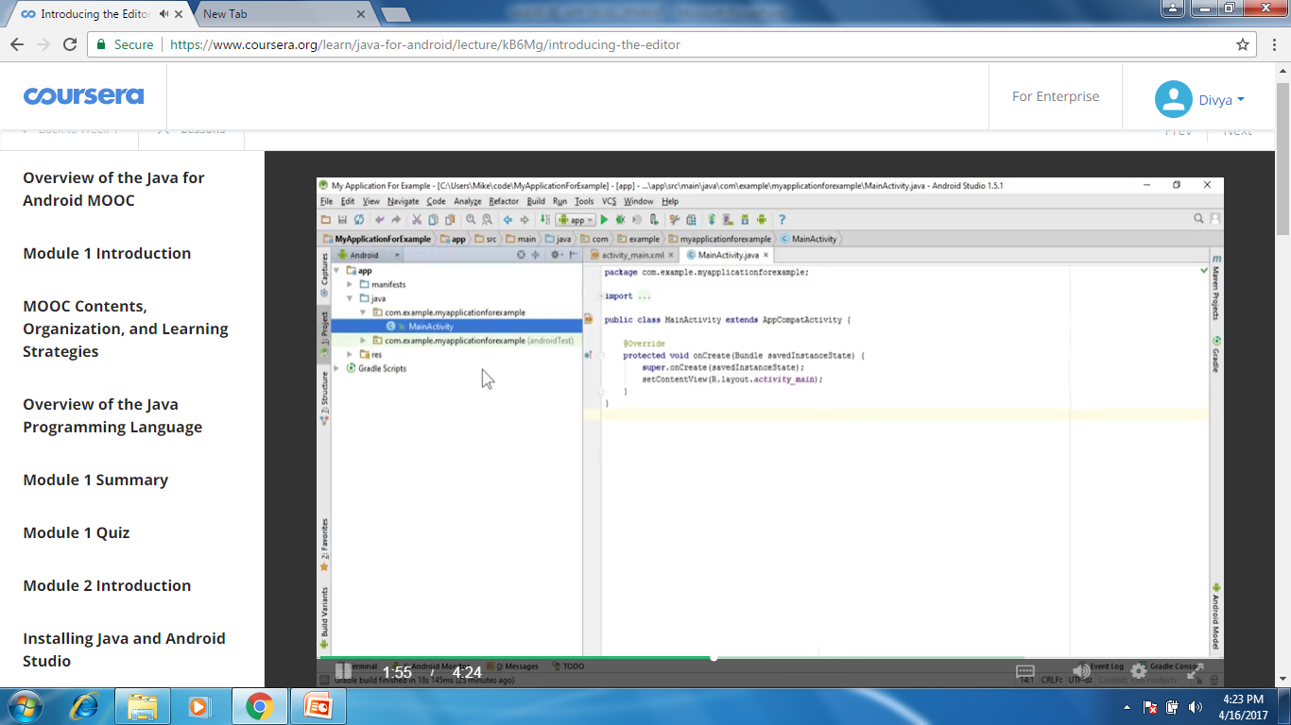
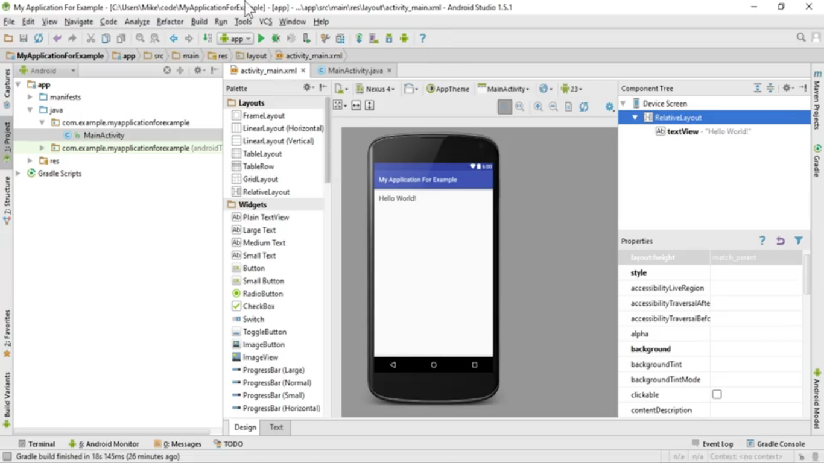
Project Files Window
Main Editor Window
Layout Editor

Slide 14
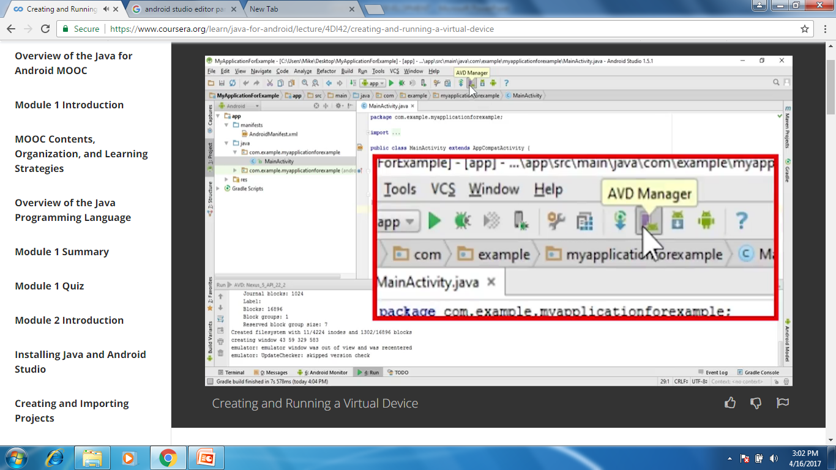
Virtual Machine Management 1. Virtual Machine 2. Run your app without physical device 3. Test your app..!!

Slide 15
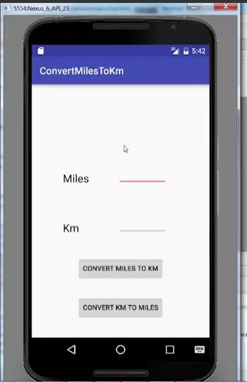

Slide 16

Advantages:
Developer : Google
Billions of users
Android Multitasking
Free download for Android
Android Notification:
Easy Access
Android widgets

Slide 17

Disadvantages:
Android advertisements
Android battery drain
Virus

Slide 18
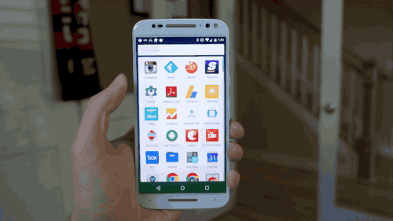
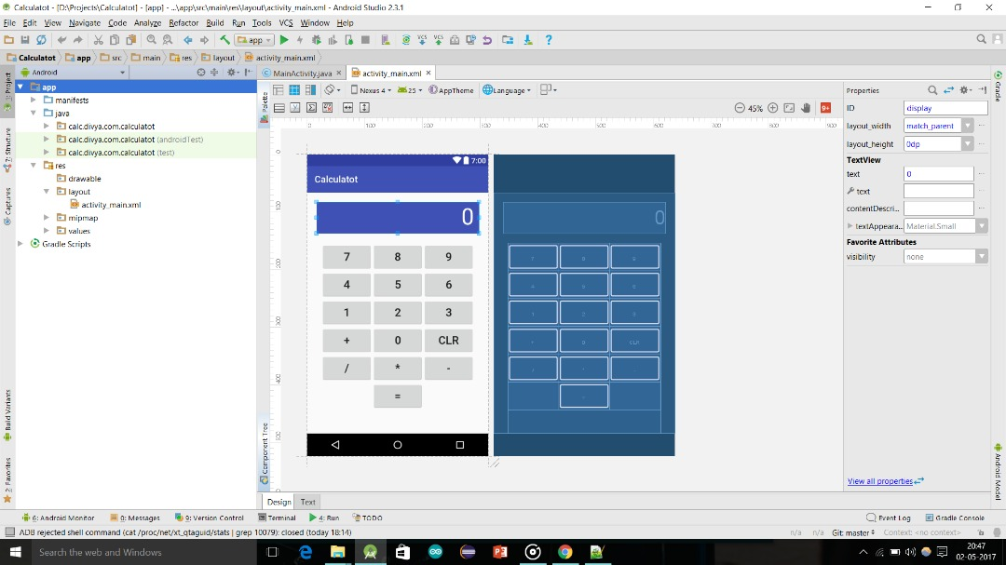
My Basic App : Calculator

Slide 19
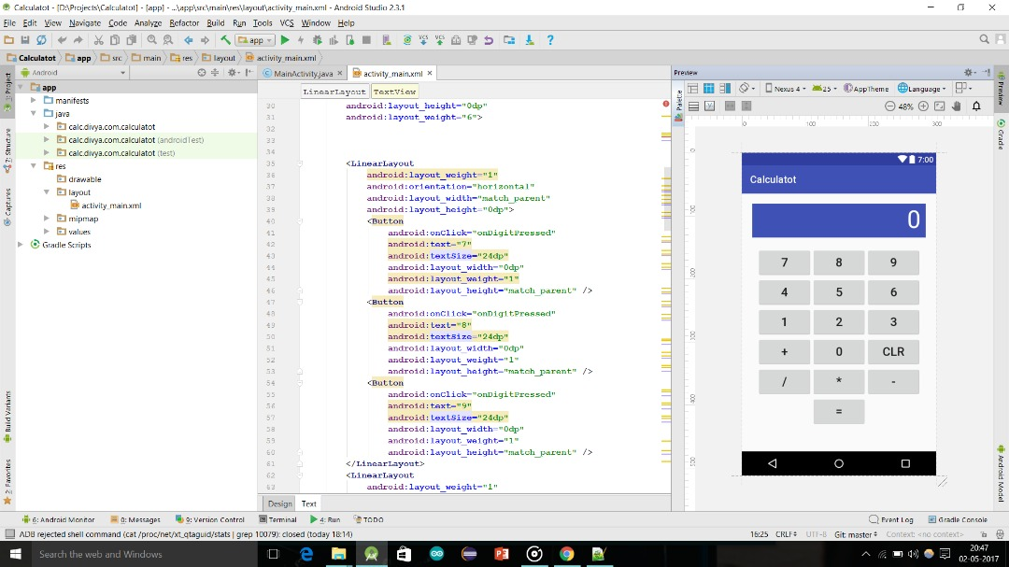

Slide 20

Java code

Slide 21
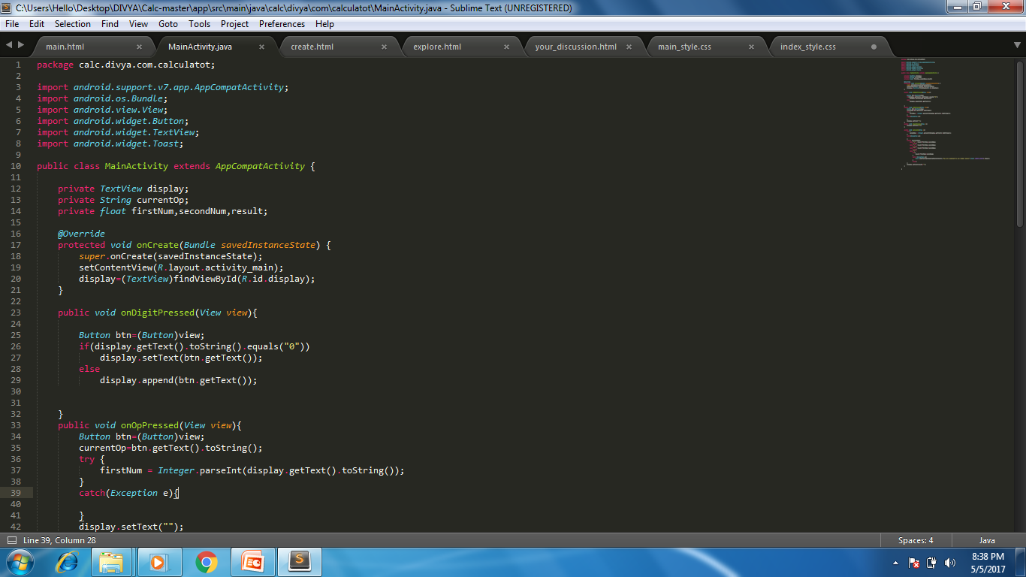

Slide 22
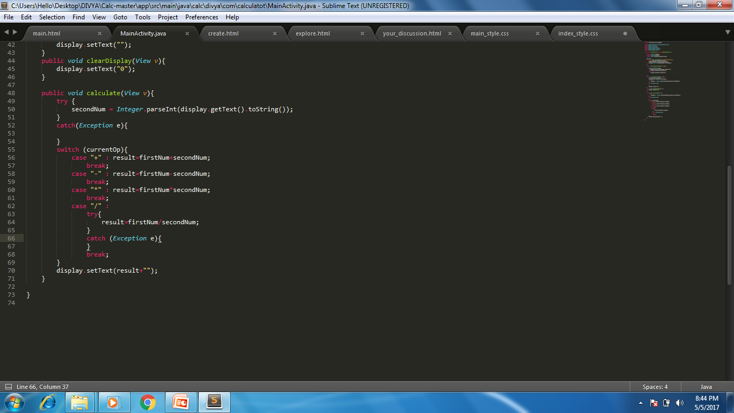

Slide 23
